Slide 1
CYCLISTIC BIKE SHARE ANALYSIS YEAR 2022
Presented by: Emerson Lucena
Last updated: June 3, 2023

Slide 2
BUSINESS TASK
Question:
How do annual members and casual riders use Cyclistic bikes differently?
Objective:
Identify the key difference between members and casual riders that can be used for marketing campaigns for casual riders to purchase an annual membership.

Slide 3
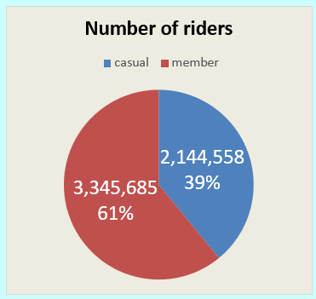
RIDERS COUNT
5,490,243 is the overall count of riders.
61% of the total riders are members.

Slide 4
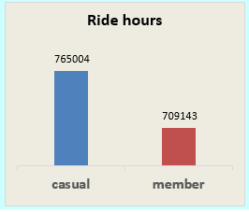
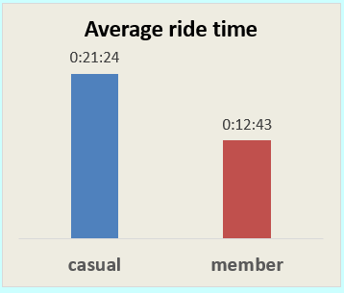
Riders time
Casual riders have more total ride hours than members
Casual riders also have more average ride time than a members

Slide 5
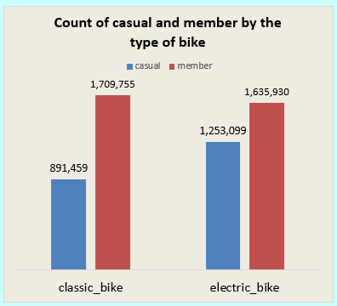
BIKE type
Members equally prefer classic and electric bikes
Casual riders prefer to ride electric bikes more than the classic bikes.

Slide 6
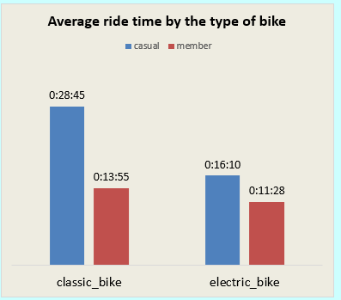
Bike type
Members have almost the same average ride time for both classic and electric bikes.
Classic bikes have more average ride time than electric bikes for casual riders.

Slide 7
conclusion
Almost 40% of the total riders are still not a member.
Casual riders have more ride time than the members.
Both members and casual riders prefer to ride electric bikes more than the classic bikes.

Slide 8
RECOMMENDATIONs
Give 10% off for casual riders when first time purchasing membership fees and 5% off for members when renewing their membership.
Provide an upgraded model of electric bike that is exclusive for members. Give a limited-time free trial for casual riders.
Launch an online campaign targeting current and potential new members across different social media platforms.

Slide 9

THANK YOU!

